Slide 1
Welcome

Slide 2
Delivering Perfect Smile

Slide 3
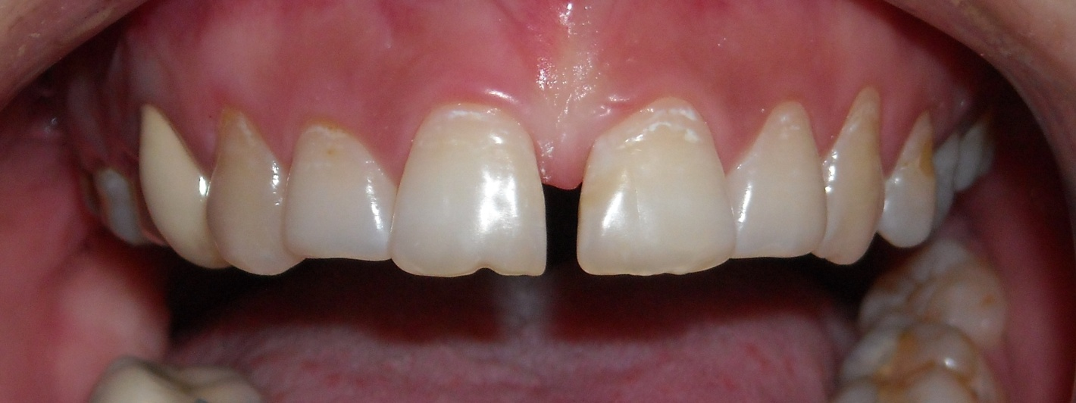
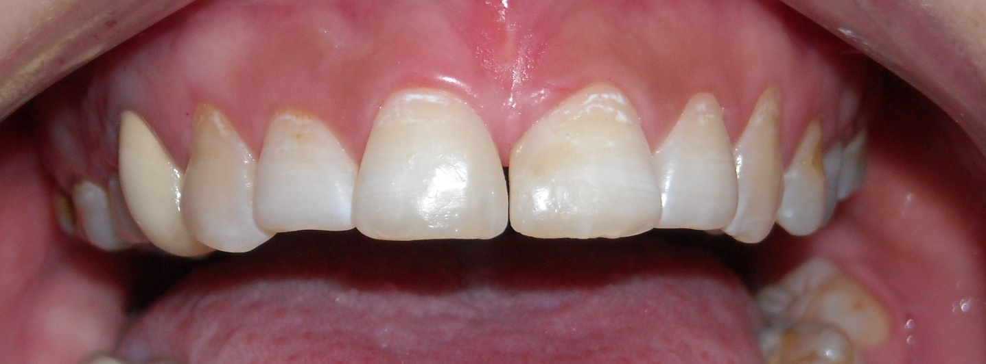
Cosmetic & Smile Design
Space Closure

Slide 4
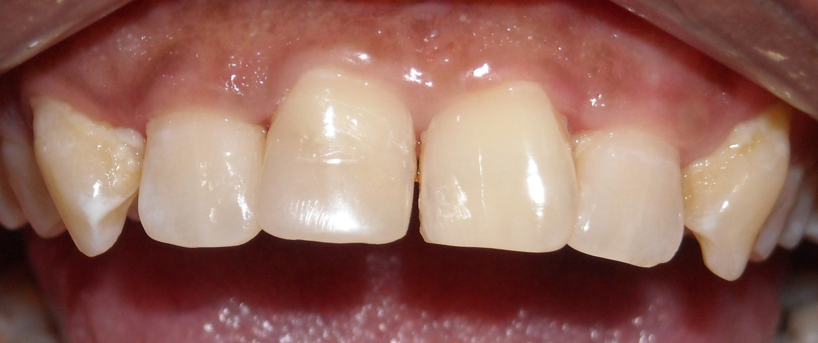
Cosmetic & Smile Design
Broken tooth restored with tooth colored material

Slide 5
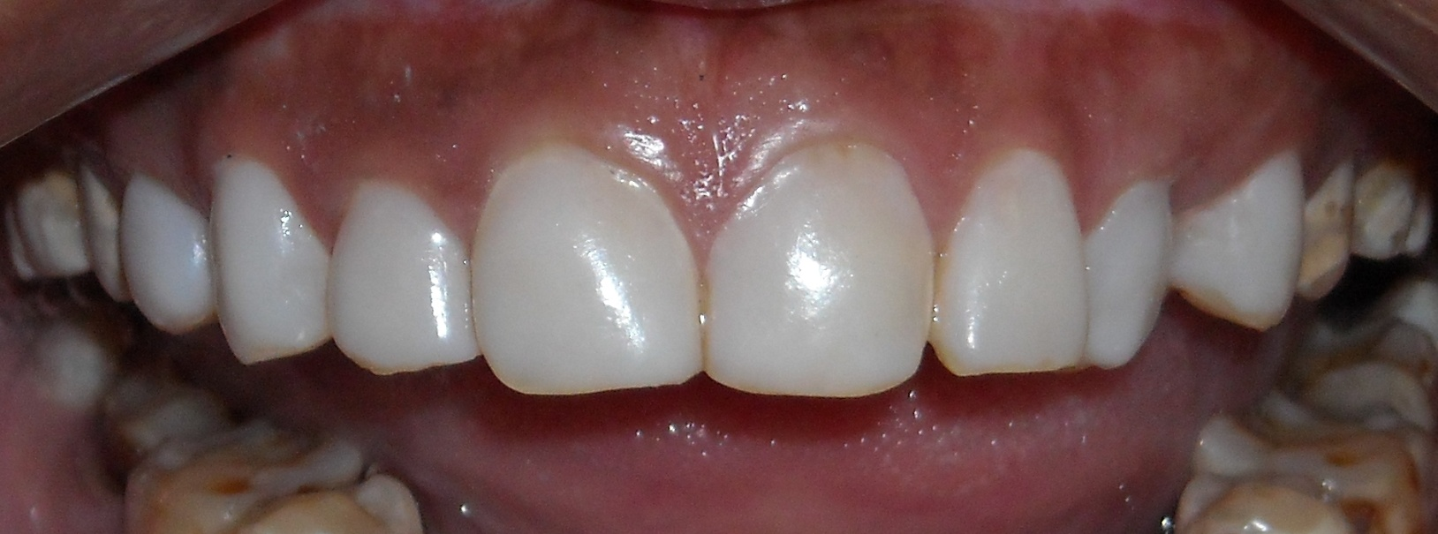
Cosmetic & Smile Design
Discolored teeth treated with Composite Lamination

Slide 6
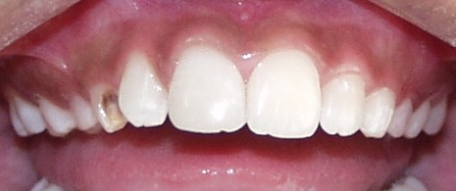
Cosmetic & Smile Design
Broken tooth restored with tooth colored material

Slide 7
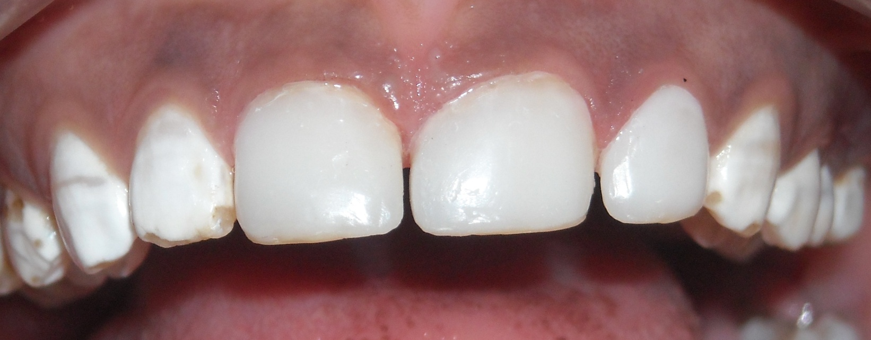
Cosmetic & Smile Design
Discolored teeth treated with Composite Lamination

Slide 8
Cosmetic & Smile Design
Before After
Office Bleaching ( Teeth Whitening )

Slide 9
Cosmetic & Smile Design
Dental Diamond

Slide 10
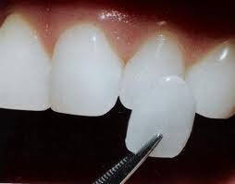
Cosmetic & Smile Design
Composite Veneering & Lamination
Teeth Stains Masking

Slide 11
Orthodontics ( Braces ) Treatment
Metal Braces Ceramic Braces

Slide 12
Orthodontics ( Braces ) Treatment
Lingual ( Inside ) Braces

Slide 13
Orthodontics ( Braces ) Treatment
Invisalign Braces

Slide 14
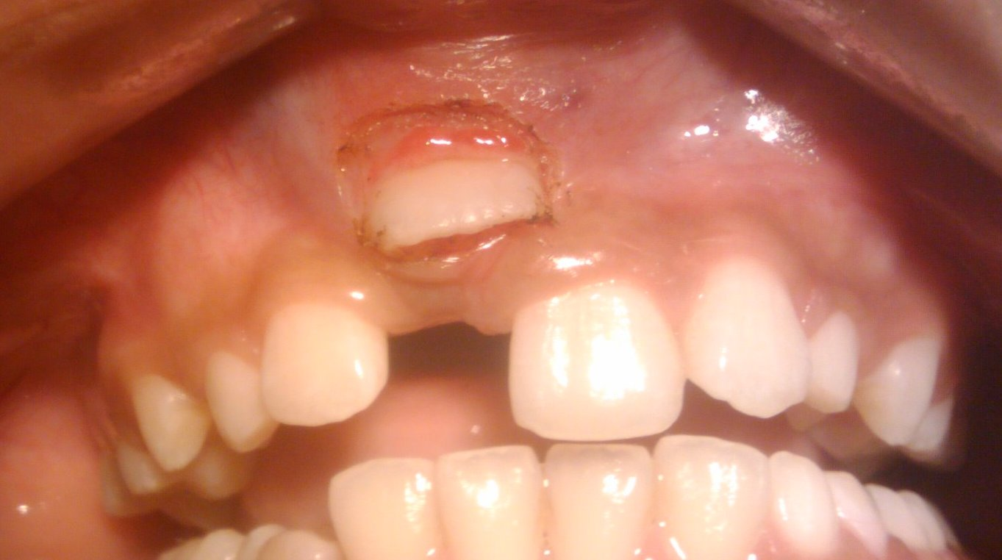
Laser in Dentistry
Exposure of un-erupted tooth with Laser

Slide 15
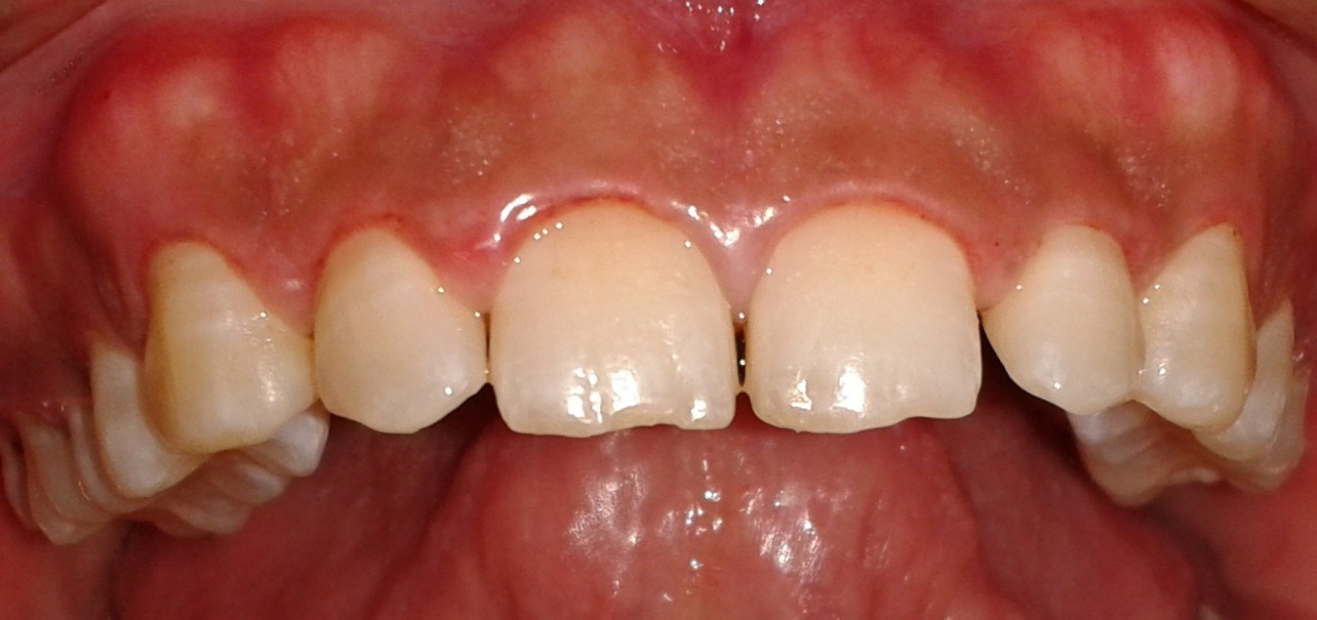
Laser in Dentistry
Teeth Lengthening

Slide 16
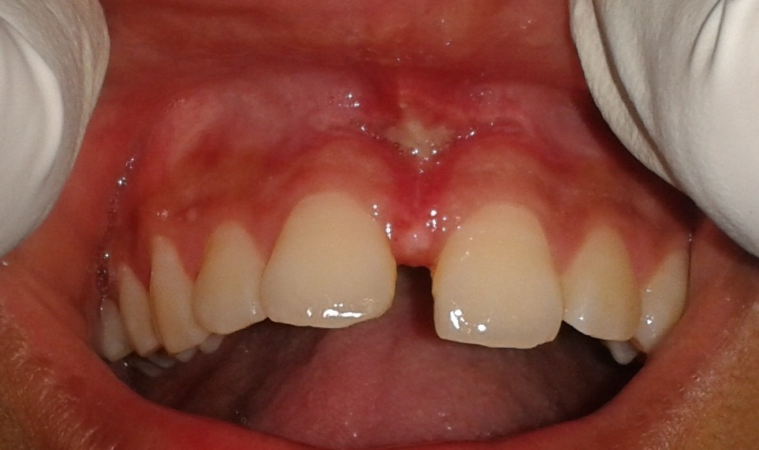
Laser in Dentistry
Removal of High Frenum Attachment

Slide 17
Laser in Dentistry
Correction of Tongue Tie

Slide 18
Laser in Dentistry
Correction of Tongue Tie

Slide 19
Cosmetic & Smile Design
Cosmetic Veneering for Discolored Teeth

Slide 20
Cosmetic & Smile Design
Diamonds– Latest Trend

Slide 21
Cosmetic & Smile Design
Cosmetic Veneering for Fractured & Discolored Tooth

Slide 22
Cosmetic & Smile Design
Space Closure

Slide 23
Cosmetic & Smile Design
camouflage

Slide 24
Cosmetic & Smile Design
Cosmetic Veneering for Discolored Teeth

Slide 25
Dentures
Flexible soft Partial Dentures

Slide 26
Dentures
Implant Supported Over Denture

Slide 27
Dentures
Metal Framework Cast Partial Dentures

Slide 28
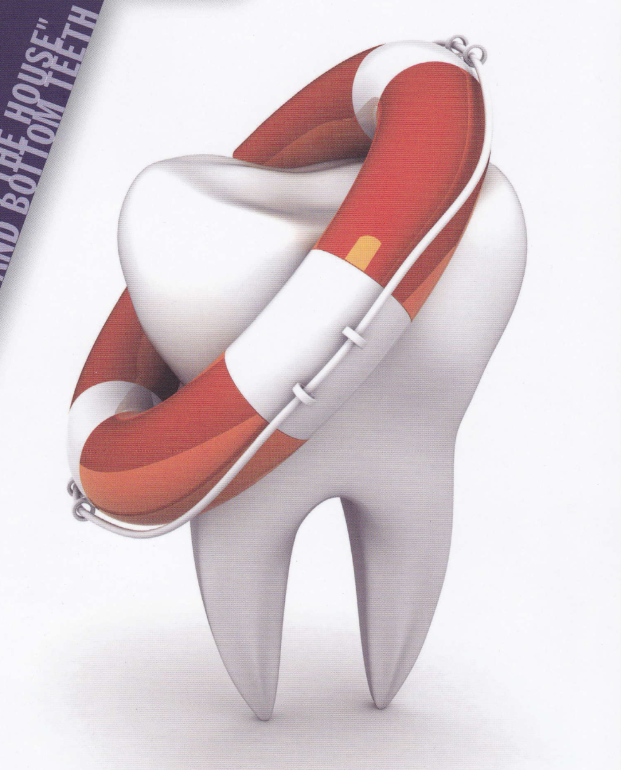

Slide 29
Cosmetic & Smile Design
Broken tooth restored with tooth colored material

Slide 30
Cosmetic & Smile Design
Broken tooth restored with tooth colored material

Slide 31
Cosmetic & Smile Design
Space Closure

Slide 32
Cosmetic & Smile Design
Space Closure

Slide 33
Cosmetic & Smile Design
Space Closure

Slide 34
Cosmetic & Smile Design
Wire Splinting for
loose teeth

Slide 35
Orthodontic ( Braces ) Treatment
Ceramic ( White ) Braces

Slide 36
Cosmetic & Smile Design
Composite Lamination over Pan-Masala Stains

Slide 37
Cosmetic & Smile Design
Lamination over Discolored Tooth

Slide 38
Dental Laser
Precancerous Lesion removed with Laser

Slide 39
Cavity Fillings
Silver Filling Composite ( White ) Filling

Slide 40
Adverse Effects of Thumb Sucking

Slide 41
Dental Laser

Slide 42
Dental Implants

Slide 43
Root Canal Treatment

Slide 44
Gum Surgery

Slide 45
Jaw Fractures

Slide 46
Implant Supported Over Denture

Slide 47
Oral Cancer

Slide 48
Different Location of Wisdom Tooth

Slide 49
Ceramic & Zirconia ( Tooth Colored ) Bridges

Slide 50
Rampant Caries

